Slide 1
Electrical Circuit Analysis Calculator
using python

Slide 2
Goal
Making simple package/module for ECA
Making simple command based Calculator
Using that module

Slide 3
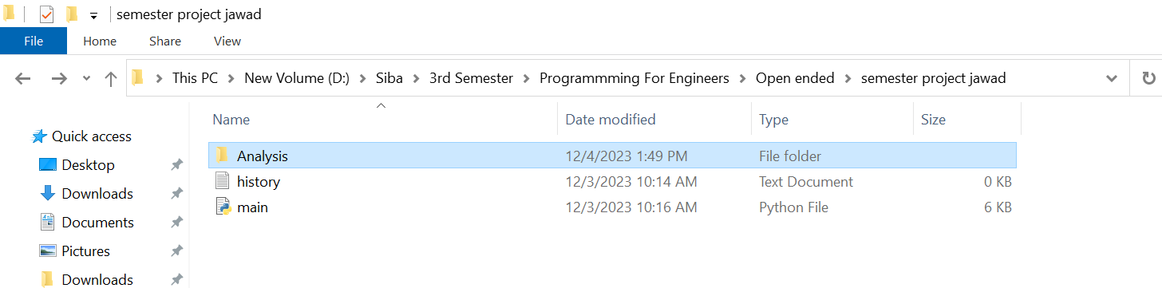
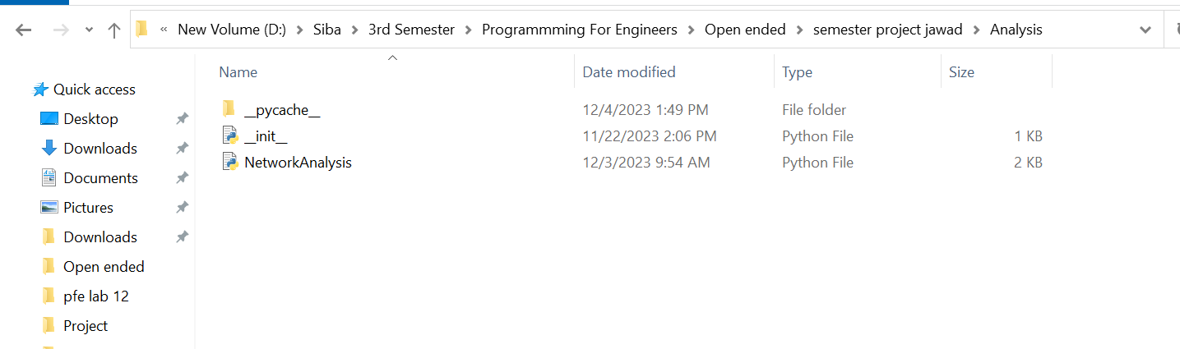
Current Directory
Package (Analysis)

Slide 4
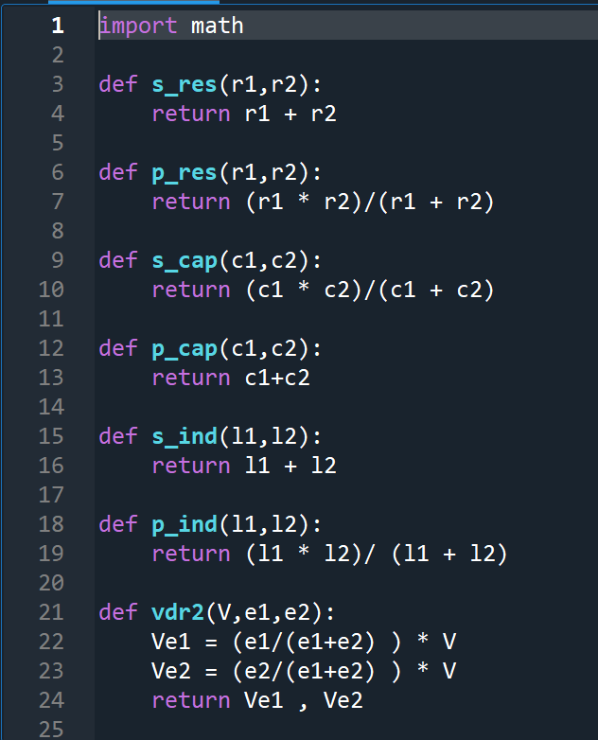
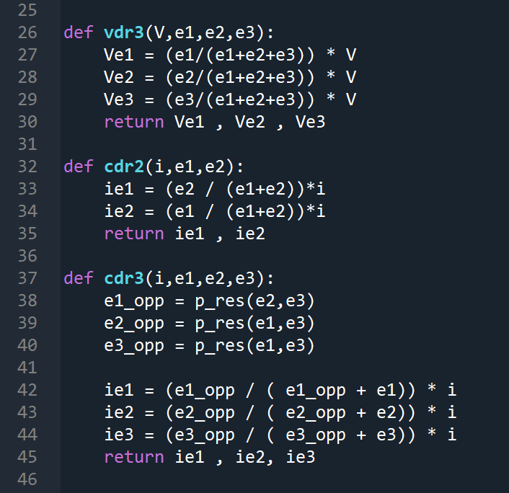
Network Analysis (Module)

Slide 5
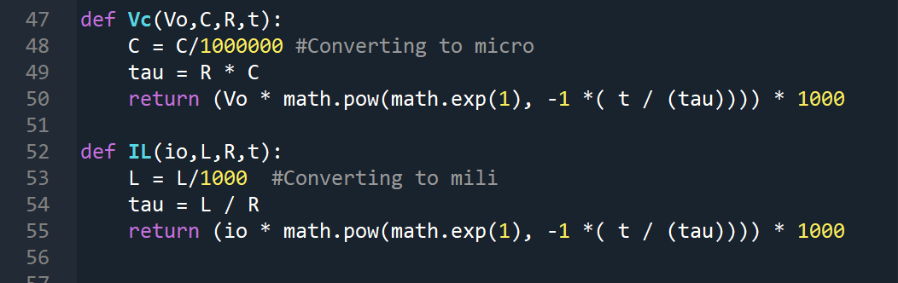
Network Analysis (Module)
V(t) = V₀(1 - e^{-t/τ}),
I(t) = I₀e^{-t/τ}

Slide 6

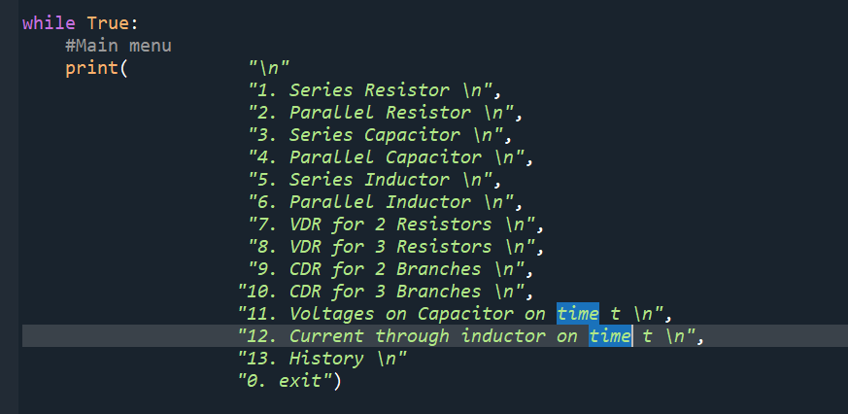
Main program
Using Module named Network Analysis
To store history using a txt file named history.txt
Main menu to be displayed

Slide 7

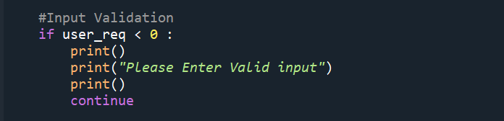
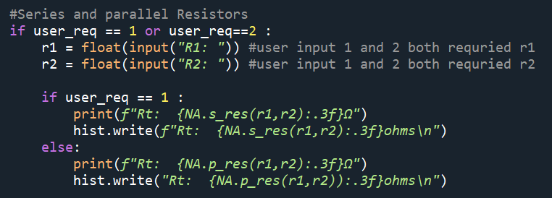
Main program

Slide 8
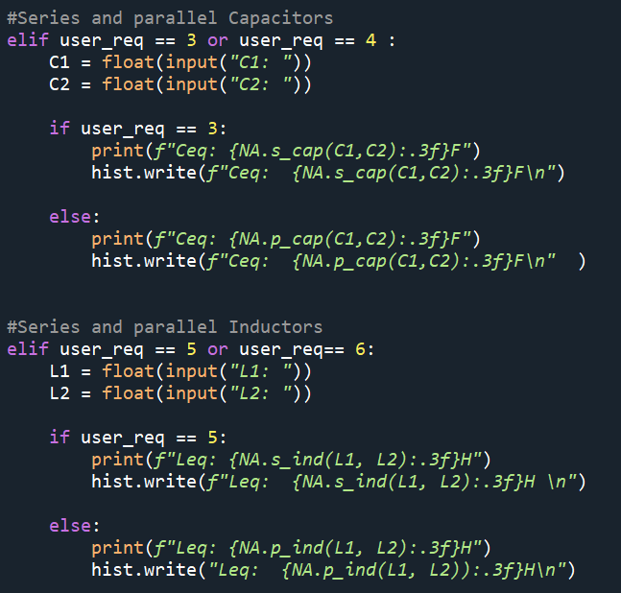

Slide 9
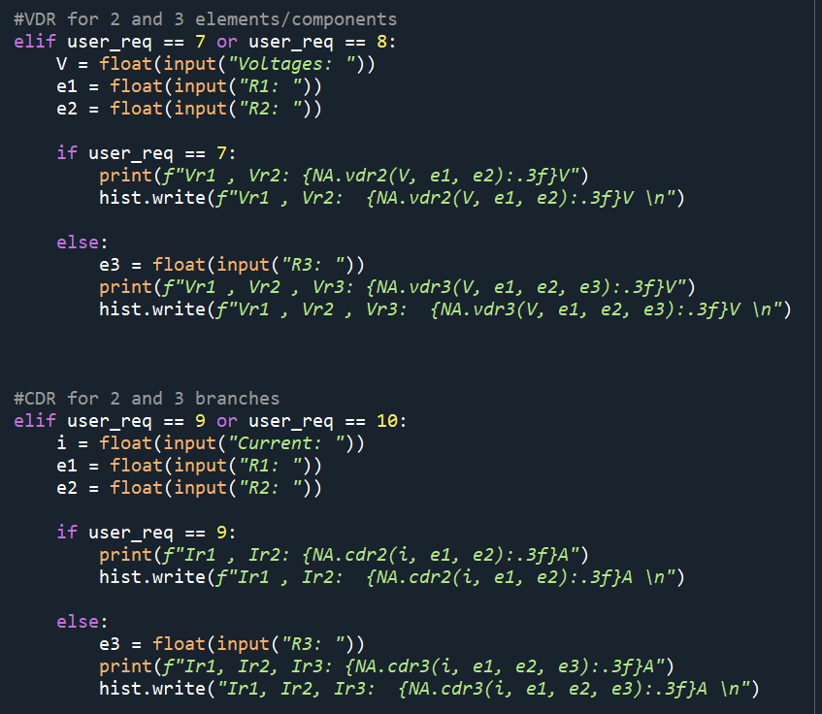

Slide 10
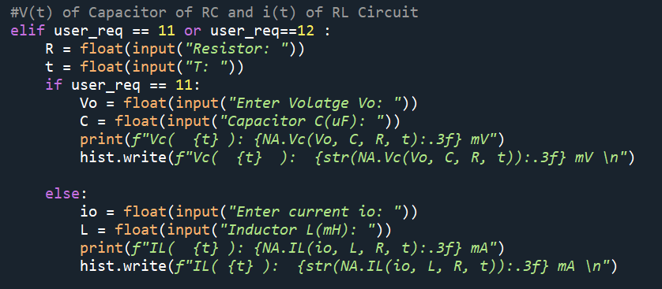

Slide 11
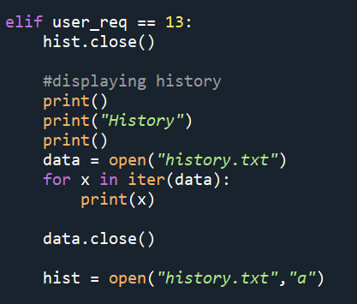
History

Slide 12
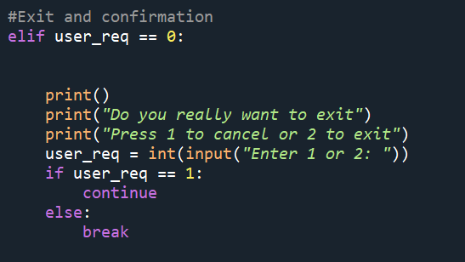
Exiting program

Slide 13
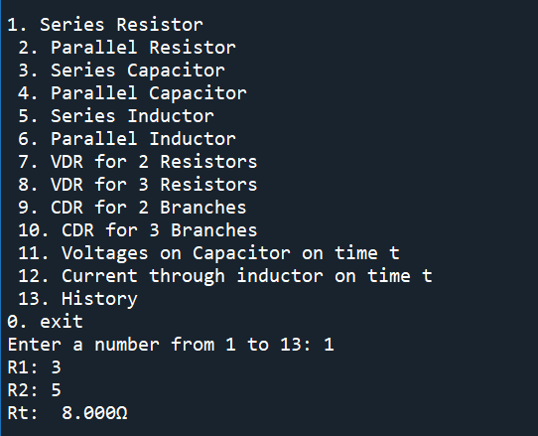
Output

Slide 14
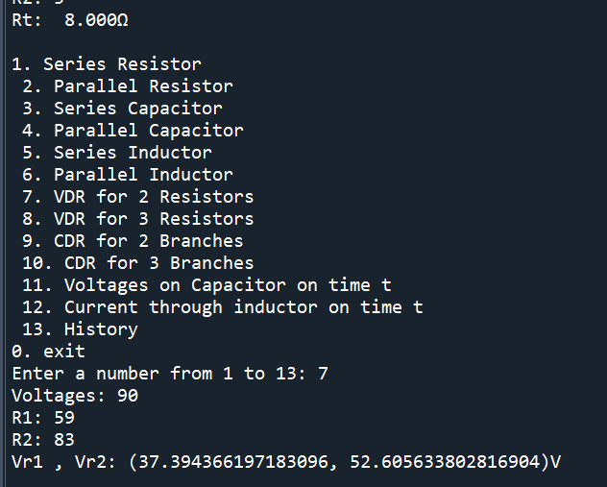
Output

Slide 15
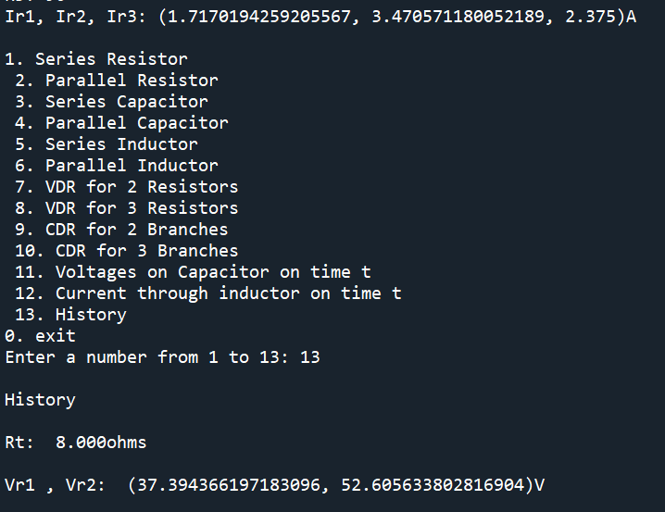
Output

Slide 16
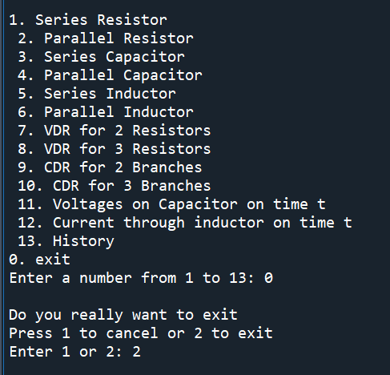
Exit program

Slide 17
Thank you

